Slide 2

Create highly engaging content experiences for each individual customer

Slide 3
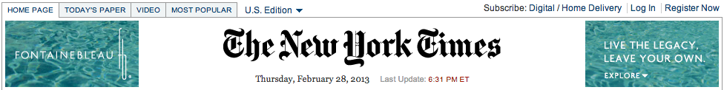
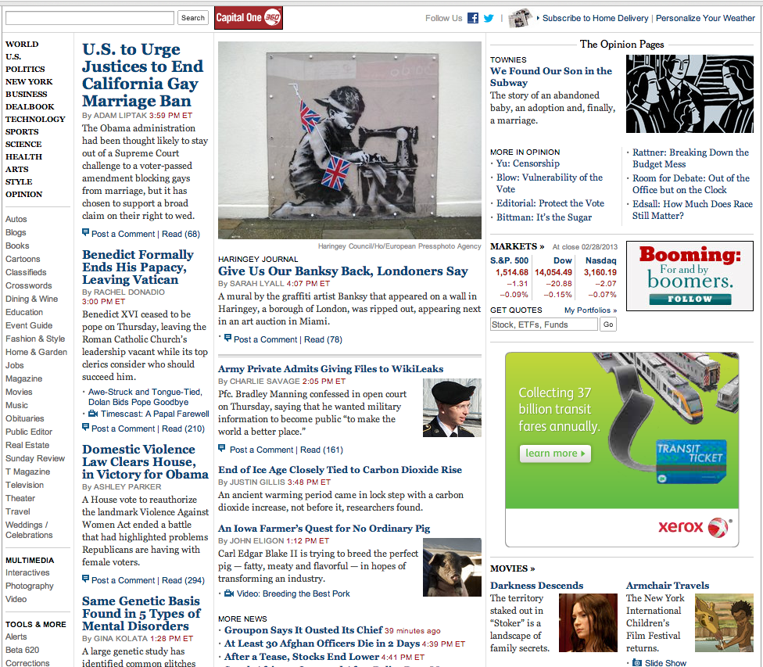
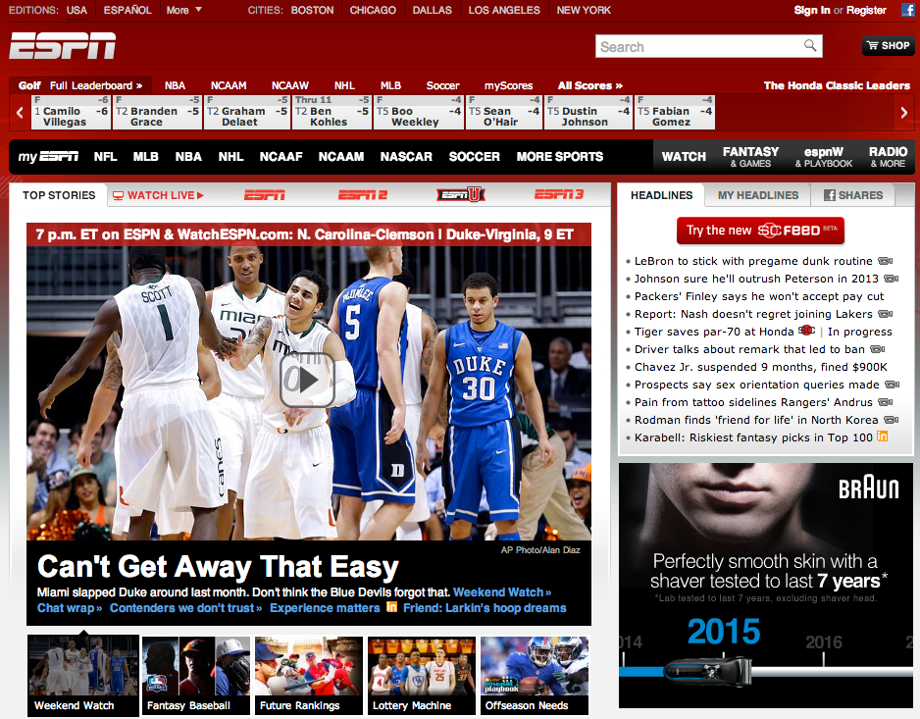
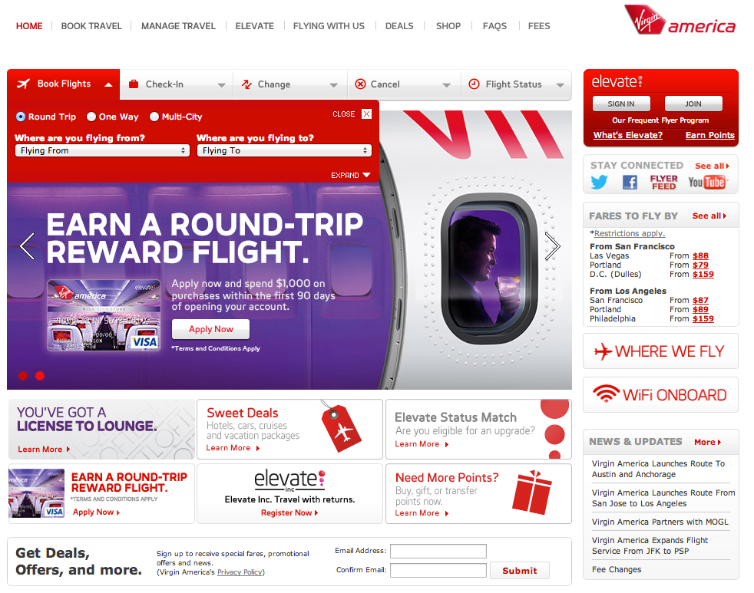
Today’s Challenges in Digital Content
Websites overloaded with content
Consumers cannot find what they want fast enough
Static websites
(again, and again)

Slide 4


“
Customers who engage with editorial content— whether that’s a Window story, a designer interview, a video, a lookbook or a personalized editorial recommendation— spend 40% more than our average customer.
”
Matthew Woolsey
EVP, Digital
Source: The Zoe Report, May 28, 2015
http://thezoereport.com/habits-of-mobile-shoppers/?mode=view-all

Slide 5





Don’t optimize your content—personalize it!
Engage takes content management to the next level.
“One-and-Done” Content Rules
Mobile First
Single View of the Customer
Retail-Centric

Slide 6
Product Overview
RichRelevance Engage™ provides retailers the unique ability to display different, targeted and relevant content to each shopper based on their individual characteristics.
By utilizing Engage, retailers build one-to-one relationships with all their customers by displaying content that engages them across all buying channels—web, mobile and in store.
Engage maps individual shopper behavior against advanced targeting and audience segmentation tools to enable marketers to personalize campaigns that deliver relevant content.
This playbook is designed to help RichRelevance’s clients understand how they can get the most from Engage.

Slide 7
Engage glossary
contents
  image, video, flash, text
tags
  grouping of contents
content catalog feed
  scheduled feed upload
  api
segments - who
  custom
  imported
contexts – where right now

Slide 8
Key Features
Auto-optimization powered by King-of-the-Hill decision
Integration with CMS providers
True omnichannel engagement
Embedded recommendations
Content tagging
Notes:
Leverages KOTH to power auto-op
Improved the UI and made it easier to use
Offer advanced targeting via …..
Allows for integration w/ CMS providers via API plugin
Enables omnichannel engagement with their respective consumers
Allows for embedded recs
Improved on the content tagged feature

Slide 9

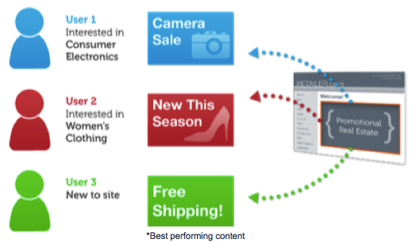
Automatically optimize your content
Leverages the same powerful King of The Hill (KOTH) technology as Recommend: optimize and measure based on the KPIs that matters to you
No need to manually run hundreds of A/B tests to choose the right creatives/content.
Notes:
So one of the key differentiating features is the auto-op of content/campaigns
What it does is we’ve now incorporated the same King of The Hill (KOTH) technology as Recommend to dynamically serve up the best content/campaign to the consumers at the right place and time
It allows the customers to optimize and measure based on the KPIs that matters to your customers such as page views, repeat visits, cart adds, conversions, etc – not just CTR
No need to manually run hundreds of A/B tests to choose the right creatives/contents.

Slide 10



Content API and Feed Ingestion
Enables quick and easy upload of large amount of contents automatically to Engage via API plugin (CMS partners) or by feeds (others).
Partnerships:
At launch –
Upcoming –
CMS
Video
Engage
Image
API
Flash
Text
Notes:
Problem:
Customers have a large amount of content in their CMS, and want to be able to access that content automatically in Engage
Solution(s):
Features for Content API and feed ingestion, enabling retailers to upload their content automatically in to Engage

Slide 11

Omnichannel
Be wherever your consumers are.
Omnichannel content – push notification
Web
Shopper mobile apps
Email
Call center apps
In-store
  Sales associate mobile apps
  Kiosk/POS apps
Omnichannel data sources (input)
Web traffic
Mobile web/app traffic
Offline data (POS)
Notes:
Be wherever your consumers are – engage with them at every single touch points
Not only would they be able to engage/ push contents to consumers at various channels, we help our clients become more aware by providing contexts. They want all of their touchpoints to be aware of what the others are up to so they don’t duplicate efforts and look silly in front of their consumers. And with 2.0, we really have got all the basis covered - from web to call center, to in-store kiosk/POS apps, sales associate mobile apps, etc etc.

Slide 12
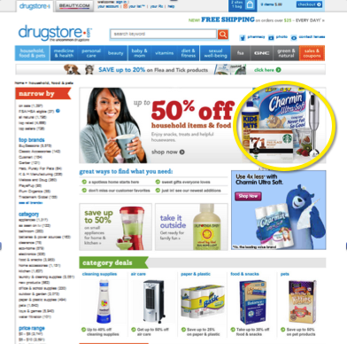
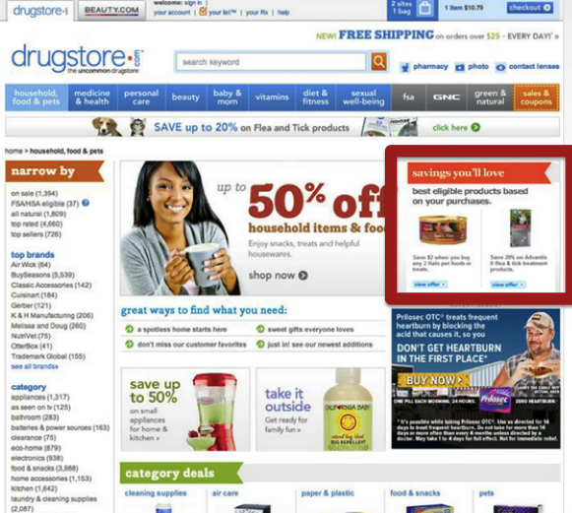
Embedded Recommendations
Content with embedded recommendations provides a much stronger CTA.
Without Embedded Rec
With Embedded Rec
Notes:
Another differentiating feature is the embedded rec, though it’s not new to 2.0, it has not been widely used currently due to low awareness. It allows the customers to embed product recommendations directly into their content, and leverage additional user data from the interactions with recs to further fine-tune the contents being served.
A piece of content with recommendations built-in makes a much stronger CTA than without → higher CTR/CVR

Slide 13
Content Tagging Management
Apply rules for managing and personalizing content in different ways
Allows tagging of contents to create groups of eligible content to be considered on various placements/pages
Notes:
Tag Management: allows customers to tag content to create groups of eligible content to be considered on various placements (tag a variety of content with “baby” label, and then we can make “baby” content eligible to be automatically displayed on the home, kids and toys pages) easily through the our dashboard without manual intervention

Slide 14
Engage: A Visual Depiction
Tag Rules Definition
Optimization by Placement
(CTR, Add to Cart, Purchase, etc)
Groups of Content – Tags (What)
Audience (Who)
Context
(Where)
CMS Providers
Tagged Content
Personalize Any Channel
Manual Rules Definition
Manual Content Upload
Audience (Who)
Context
(Where)
Content (What)

Slide 15
Use cases

Slide 16

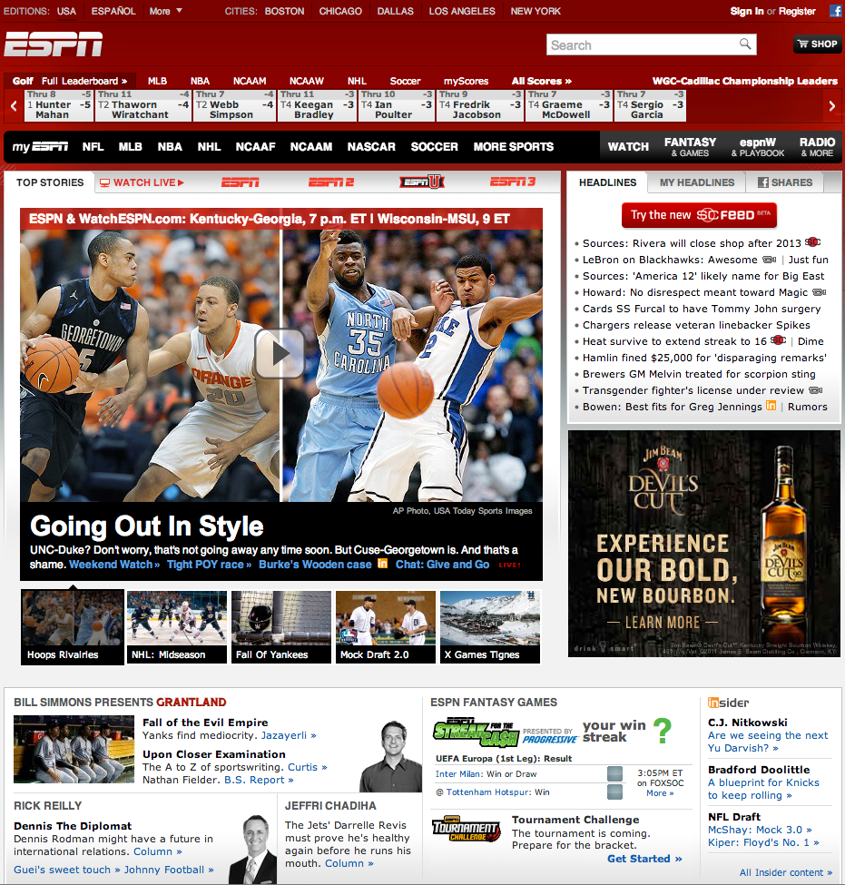

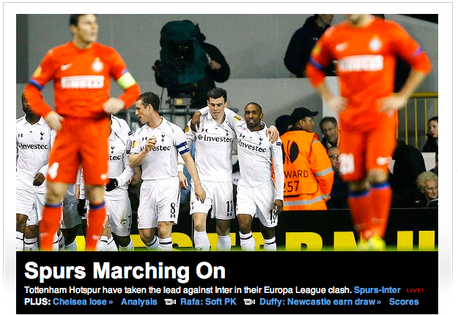
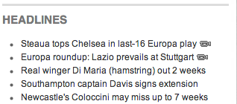









Soccer
Tennis
More Videos Recommended for You
Notes:
ESPN.com hosts thousands of video content of their programming. Their content is organized mostly by top level categories - Sport.
Bob has visited ESPN.com a few times. Bob is interested in watching soccer and tennis videos mostly. However, every time he arrives at ESPN.com, he sees the same content on the home page - NFL, NBA, NHL, NCAA. These are the most common videos viewed by the ESPN.com visitor population. Bob finds it cumbersome to find the Spanish La Liga soccer highlight videos he likes because he needs to navigate through many clicks to get to it. Bob loses interest and doesn't return back to ESPN.com
RichRelevance knows that Bob likes soccer and tennis because he told us implicitly: he watched videos (tagged with 'soccer' and 'tennis') in the past. When Bob comes back to Espn.com, RR will immediately greet him with the most popular, newest, most watched, most liked Soccer and Tennis videos. Bob is engaged immediately with the site. The more he interacts with the site the more relevant content he sees.

Slide 17

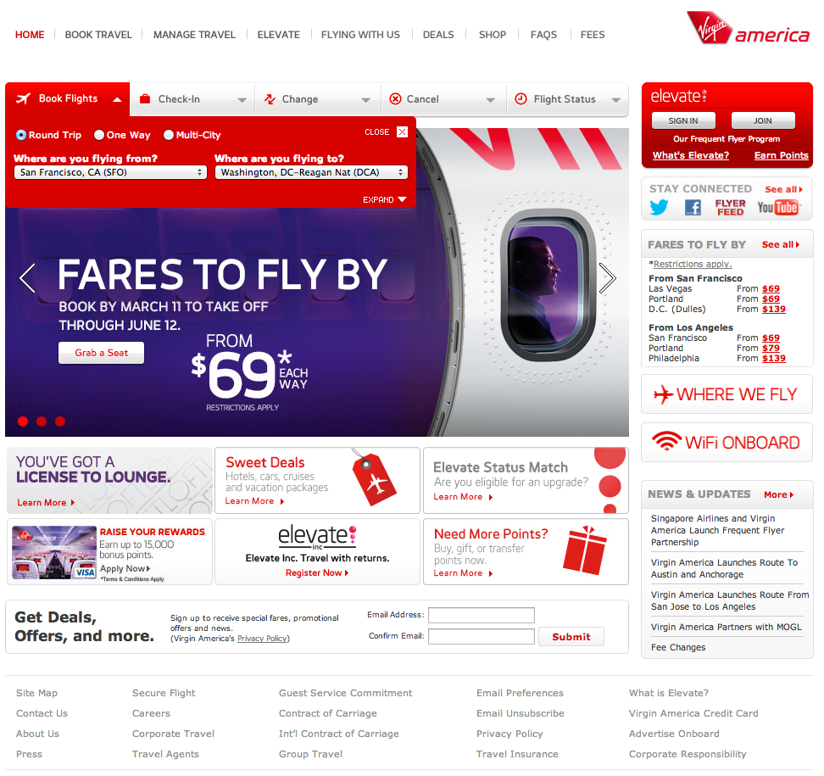

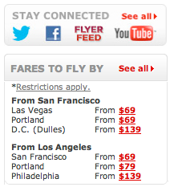


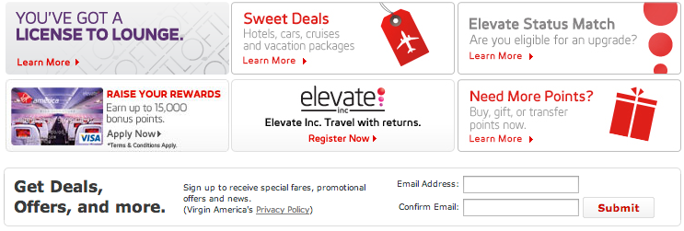
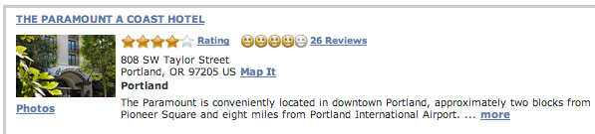
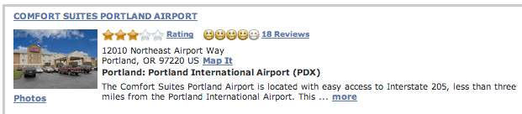
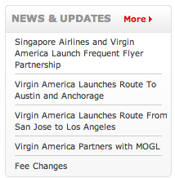


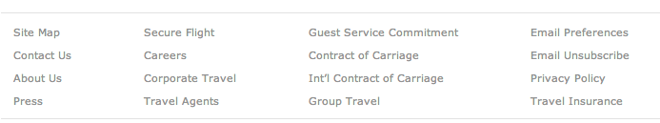
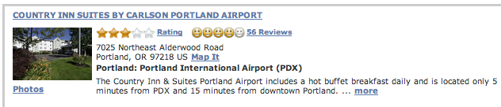
My Virgin
FLIGHTS FOR YOU
HOTELS DEALS IN PORTLAND FOR YOU
NEWS & UPDATES
Notes:
Virgin has a robust site that is categorized by what kind of travel you are looking to book (flight, hotel, cars, etc). It also has a very loyal following of ELEVATE members who are frequent Virgin flyers.
While there are many different avenues that each individual customer could explore, repeat patterns are generally ignored.
Courtney has flown with Virgin several times. She travels constantly for work and her departure city is usually either SFO or LAX (explicit data). Her company’s other offices are located in Portland, DC and Philadelphia, and she flies to these locations most often. We know this because she is a frequent visitor to Virgin’s site, so instead of having her start from scratch on each page, why not do some of the work for her and personalize her page to match her actions (by using implicit and explicit data to personalize).
Voila– Courtney loves to book her travel plans through Virgin because it is less time consuming, helpful, and an overall better experience.

Slide 18



Landing Page Optimization
Notes:
By the way, all the new Segment/Targeting features will allow us to pitch Engage to a much broader audience than what we have been used to. These phenomenal features make Engage an invaluable companion for Landing Page Optimization folks – this is huge not only for all promotional managers and site conversion folks , but also huge for all traffic acquisition / paid search managers, for whom we had no scalable offering before.
Landing Page Optimization – if you have a SEM campaign or other marketing campaigns on another site, you can target content to show on your site when they arrive there
This absolutely broadens our appeal with all matter of performance marketing experts and take us way ahead of the pack

Slide 19
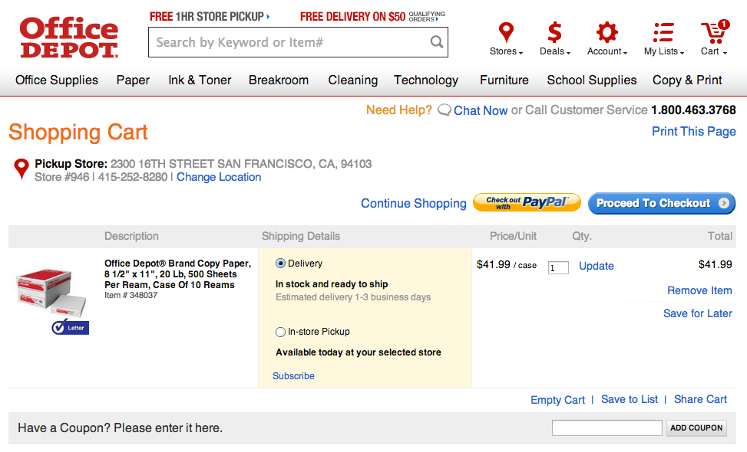
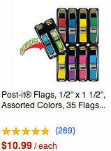
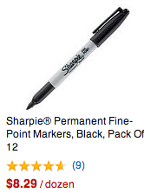
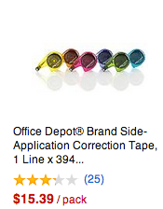
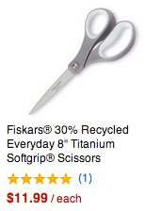

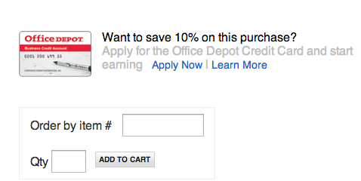
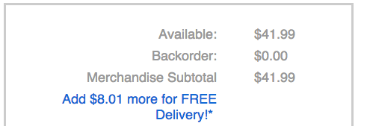
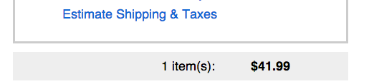
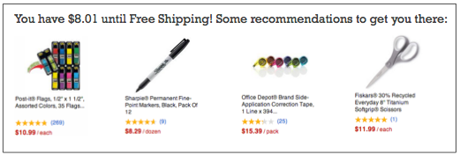
“Smart Cart” Free Shipping
You have $8.01 until Free Shipping! Some recommendations to get you there:

Slide 20
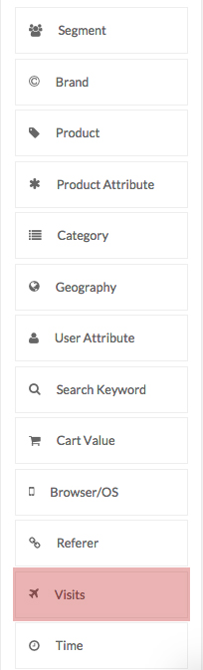
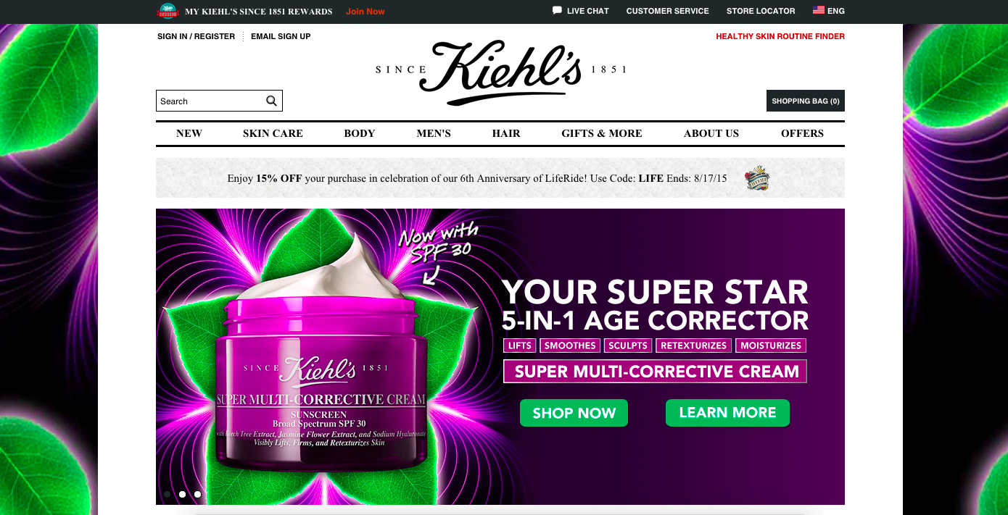
Visits: First Time
Engage Use Cases: Simple

Slide 21
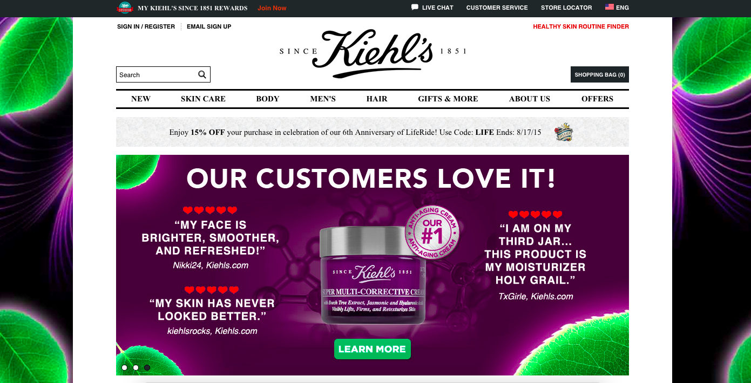
Visits: Returning User (within 7 days)
Engage Use Cases: Simple

Slide 22
Visits: Returning User (beyond 7 days)
Engage Use Cases: Simple

Slide 23
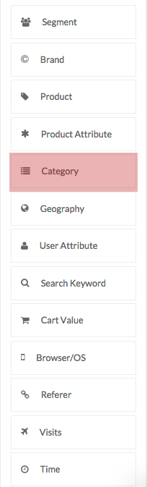
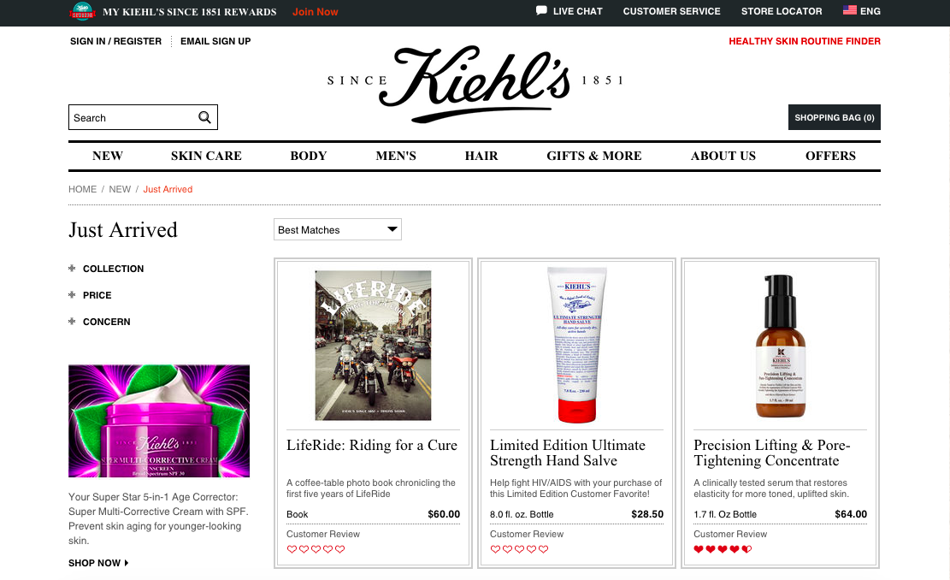

Category: Interacted w/ Gifts & More
Engage Use Cases: Simple

Slide 24

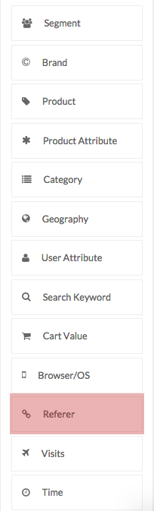
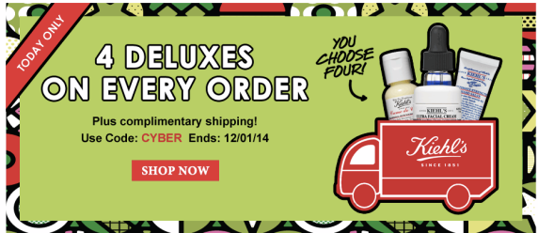

Referrer: Domain
Engage Use Cases: Simple

Slide 25
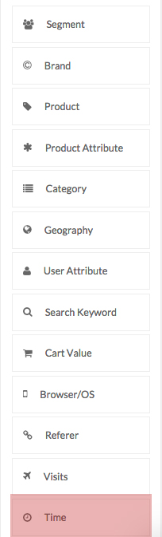
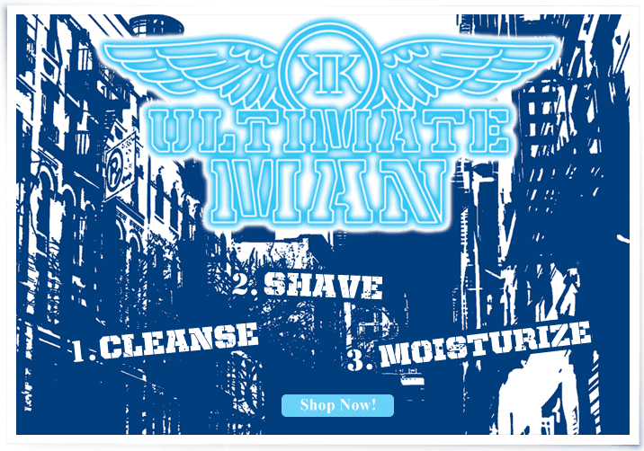
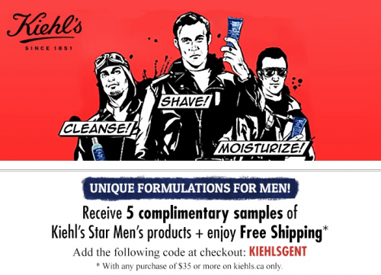

Time: Days of the Week (Sat & Sun)
Engage Use Cases: Simple

Slide 26
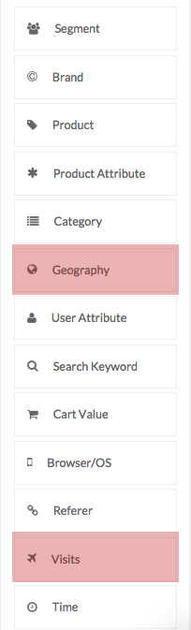
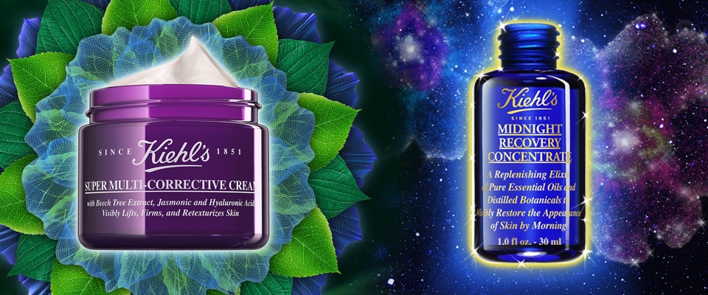
Visits + Geography: Returning, Canada
Engage Use Cases: Complex

Slide 27
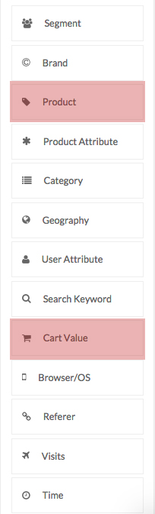

Product + Cart: Clearly Corrective™, $250
Engage Use Cases: Complex

Slide 28
Product + Cart: Clearly Corrective™, $250
Engage Use Cases: Complex

Slide 29
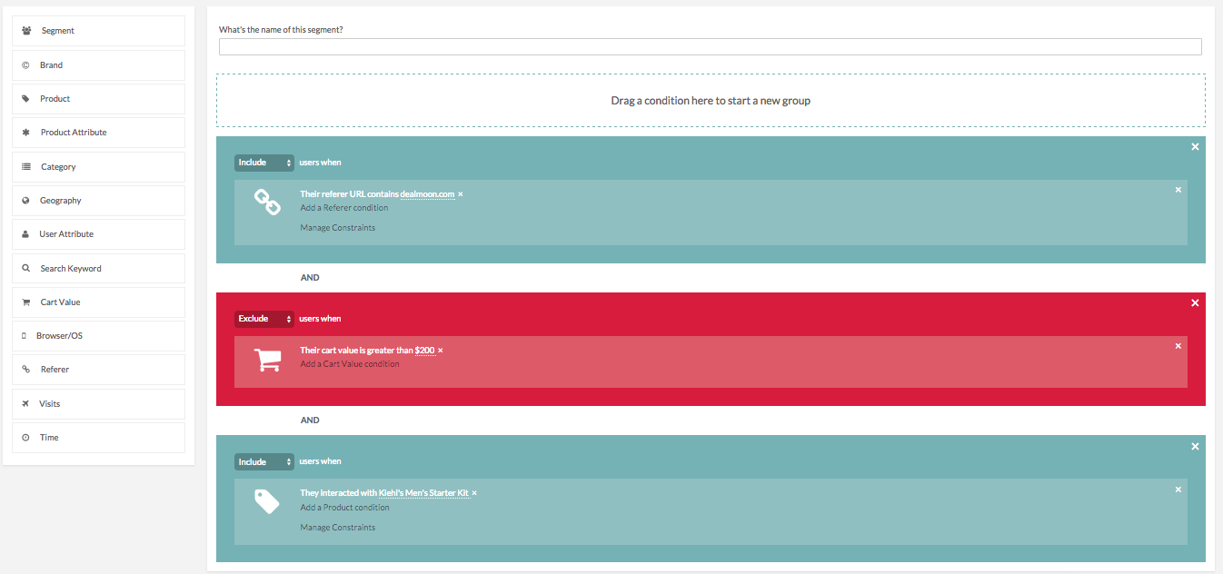
Dealmoon, <$200, Men’s starter Kit
Engage Use Cases: Drag & Drop

Slide 30

A customer has purchased a vacuum cleaner 3 months ago, but not yet bought a new set of vacuum bags. When they are returning after 3 months, on homepage show a banner to propose they take opportunity to re-stock on the specific bags fitting their machine.
Category purchase

Slide 31
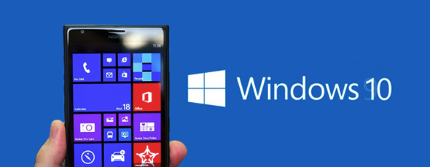
Earn market development funds (MDF), by selling a platform/device switch campaigns. Ex. customers who are visiting the website from an Apple phone but not have bought a Windows phone in last 6 months, Microsoft could fund a campaign to show them content with benefit of switching to the new Windows 10 mobile. Same can be done with Mac vs. PC etc. And same concept can also be re-used to not show such banner to people who already are visiting from a Windows phone (increased relevance).
Browser/OS

Slide 32
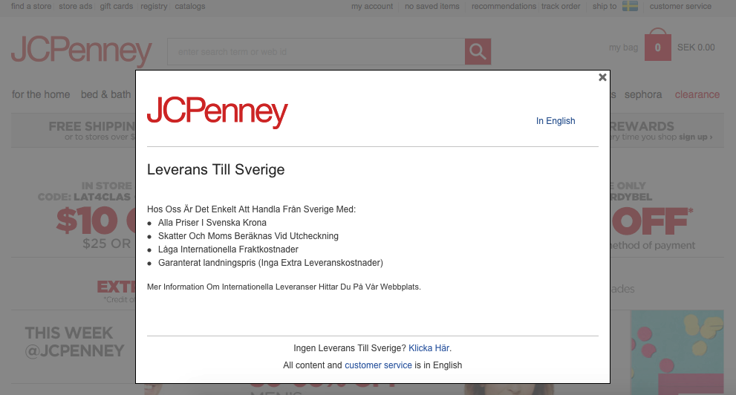
For international visitors arriving for the first time, on homepage show them a localized message explaining that delivery is available to their home country
Visits: First time + Geography

Slide 33
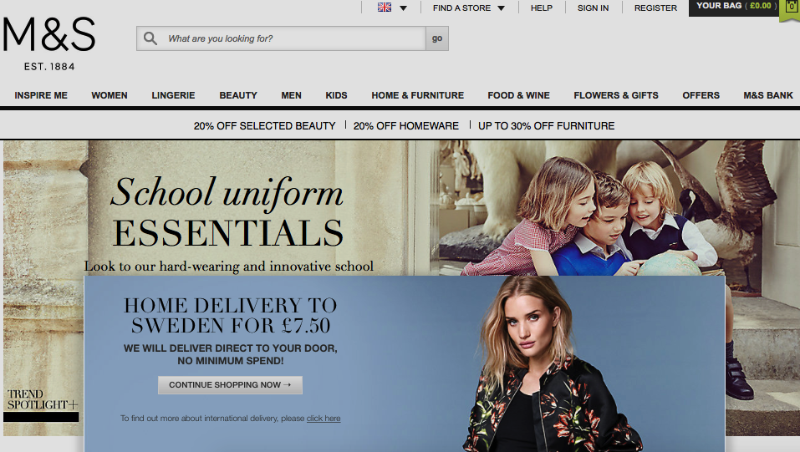
or in English but local for the country visitor is arriving from…
Visits: First time + Geography

Slide 34

A customer has previously bought a product with a slim fit attribute more than two times, this rule will on next visit on homepage select a slim fit shirt/jeans banner our of the apparel selection of content. Can also be applied for display via Content in Email.
Previous purchase + Product attribute

Slide 35
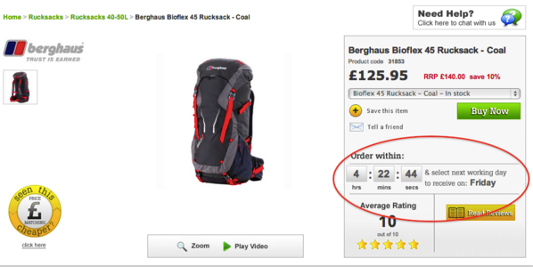
Next day delivery order cut off time is 2pm, one hour before start showing a banner on item page with a count down
Time of day

Slide 36
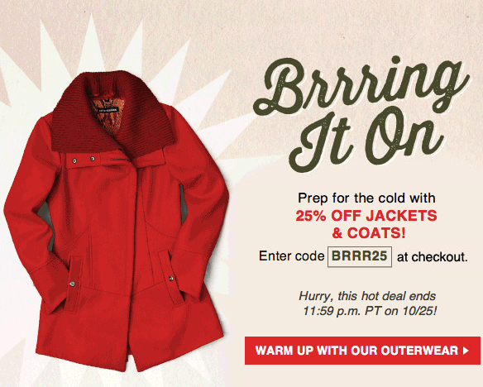
For content with an end time mid day, use a count down (HTML/JavaScript insert) on category page to reinforce the urgency to act fast
Time of day

Slide 37
Appendix

Slide 38
Promo v/s Engage – Segment targeting
Functionality | RichPromo | Engage
Brand affinity* | Yes | Yes
Category affinity* | Yes | Yes but easier to add multiple categories
Product affinity* | No | Yes
Product attribute affinity* | No | Yes
Geo-targeting | Yes | Yes
User attribute targeting* | Yes | Yes
Search term* | No | Yes
Cart Value | Yes but only limited to a mix-max range | Yes but also includes <,>
Browser, OS and Device combination targeting* | No | Yes
Referrer targeting* | No | Yes but includes referrer URL contains, Query Param, regex matching
Visits – first time, frequent, infrequent* | No | Yes
Time frame – Time of the day/ Day of the week | No | Yes
Reusing previous segments | No | Yes
Enhanced constraints within each targeting condition | No | Yes
Compounding imported segments and custom segments | No | Yes
Ability to exclude if not fulfilling the above condition(s) | No | Yes

Slide 39
Promo v/s Engage – Context targeting
Functionality | RichPromo | Engage
Brand context | No | Yes
Category context | Yes | Yes
Product context | No | Yes
Product attribute context | No | Yes
Search term context | No | Yes
Referrer context | Yes but only for domains | Yes but includes referrer URL contains, Query Param, regex matching
Current URL context | No | Yes
Time frame – Time of the day/ Day of the week | No | Yes
Page Type context | No | Yes
Placement context | Yes | Yes
Channel context | No | Yes
Ability to exclude if not fulfilling the above condition(s) | No | Yes
Reuse previous contexts | No | Yes
Functionality

Slide 40

Thank You!

